Slide 1





Honesty
Truth
Year 3 & 4 - Lesson One

Slide 2

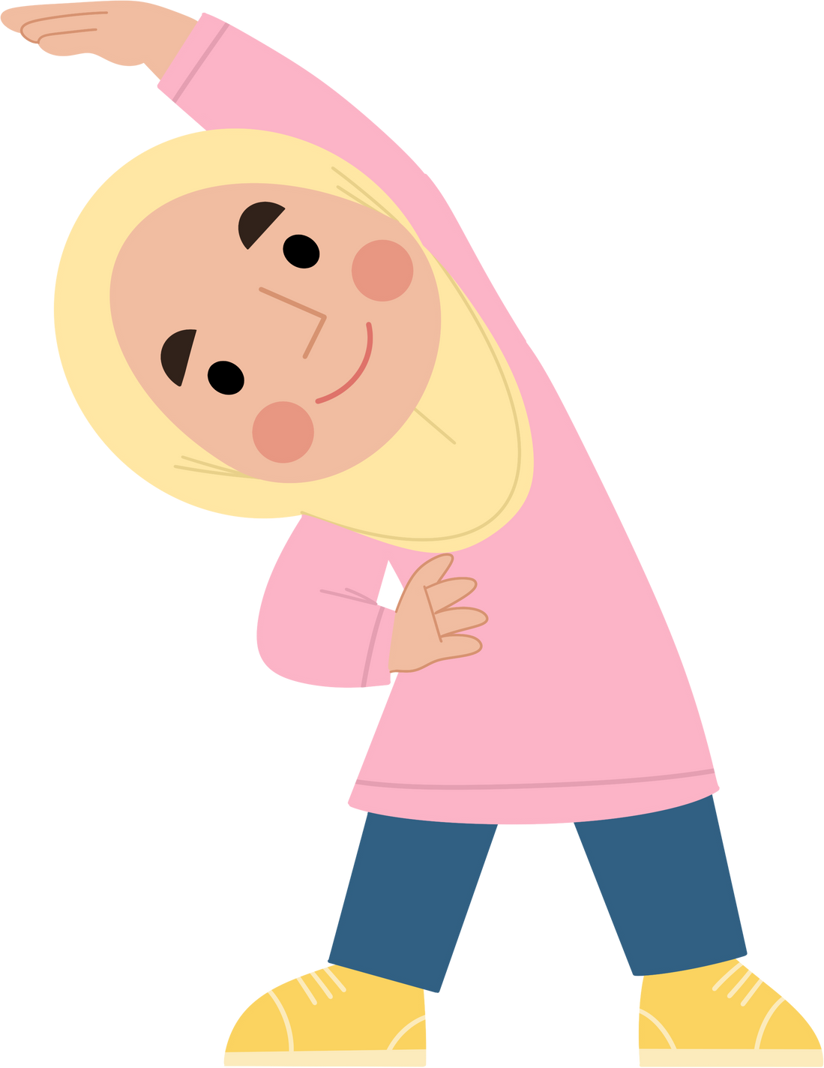
Warm Up!

Slide 3
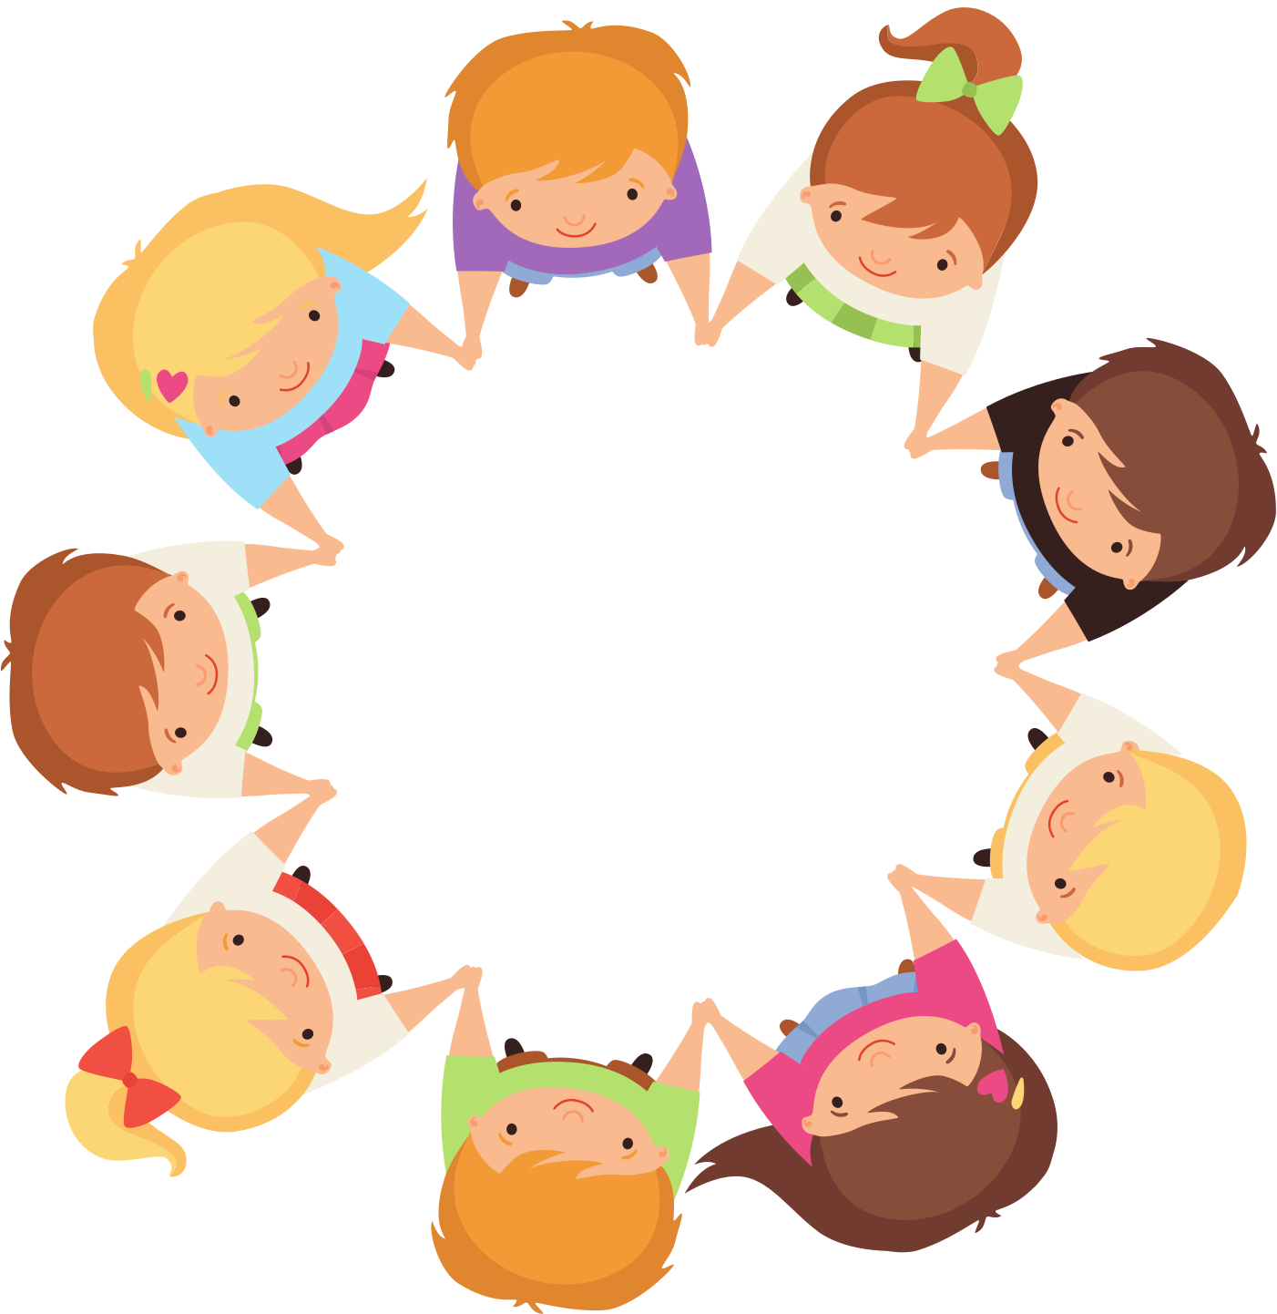

The Hand Squeeze Game!
Students sit in a circle holding hands
Calmly and gently, they pass a hand squeeze around the circle
Complete three rounds
Change directions and who starts first!

Slide 4

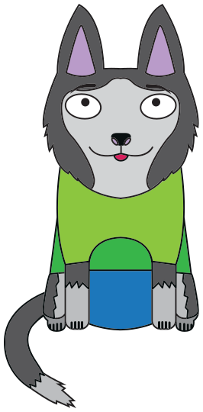



Hi! I’m Honest Ollie!
Today, we’re going
to investigate telling
the TRUTH!
Honesty
Honest
Ollie

Slide 5
Learning Intention:
I am learning about honesty and why it is important
Success Criteria:
I can give examples of what honesty is
I can discuss why being truthful is important
I can explain how honesty is a form of kindness.
This Is Because:
When we are honest, our friends and families trust and respect us. Honesty helps our minds and bodies feel
happier too!

Slide 6



I DO
You Watch

Slide 7

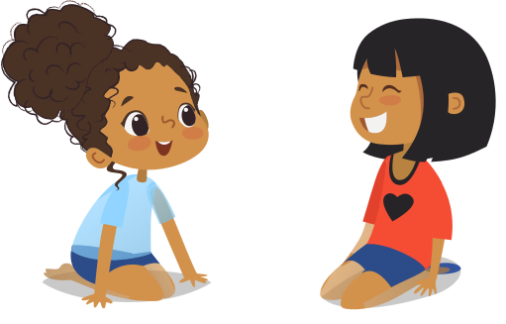
about HONESTY!
What does honesty mean to you?
Why is honesty or telling the truth important?
How does it feel inside of your body to tell the truth?
Is it easy to always tell the truth?
What is the opposite of honesty?
When you are dishonest how does it feel in your body?
Why do you think honesty is a form of kindness?

Slide 8





Honesty is...
Whole Class Definition:

Slide 9

Honest Ollie says:
“Honesty is speaking truthfully and behaving truthfully
even when it is hard.
Speaking truthfully means we ONLY say what truly happened. Behaving truthfully means we treat others and their belongings respectfully.”
Honest
Ollie

Slide 10

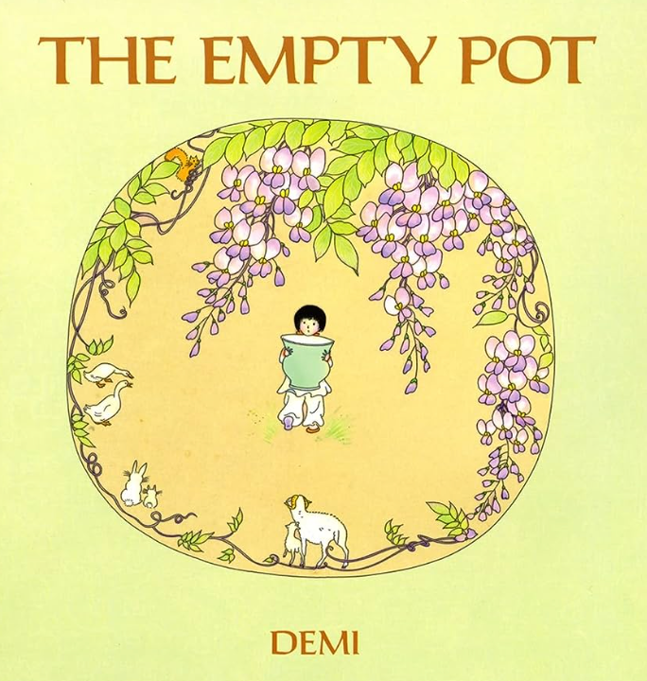


Slide 11

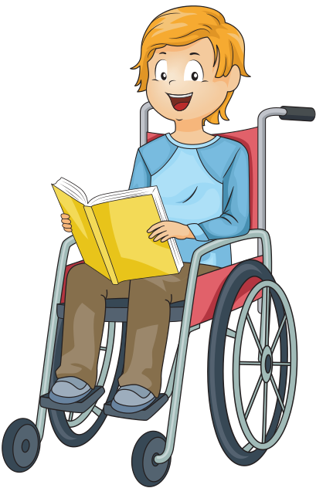
Question Time!
Why did Pings flowers never grow?
What choices could Ping have made when he discovered his flowers were not growing?
If Ping did choose to put other flower seeds into the pot, how
would the story have ended differently?
Why was the emperor impressed with Ping?
How was Ping rewarded for his honesty?
What do you think the moral of the story is?

Slide 12
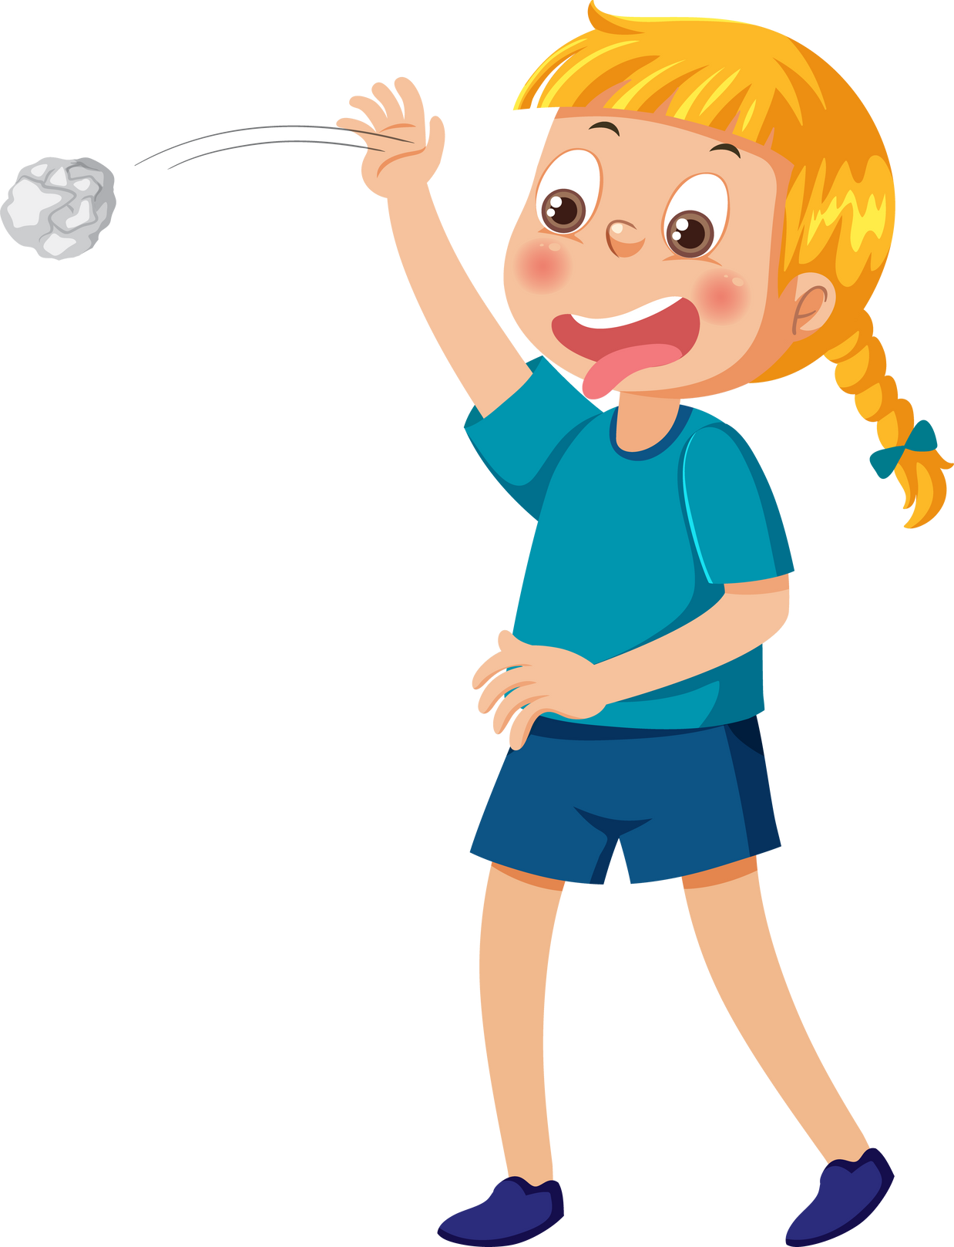



The Ripple Effect
When we tell the truth OR we tell a lie, the things we say do not just effect us, it effects those around us too.
This is called, The Ripple Effect. It is the effect of our actions on others.
Discuss the picture below. Discuss how the people below would be effected differently with Ping being truthful or if he was to be dishonest.
o
C
E
n
u
C
P
m
p
i
h
i
t
l
d
g
n
e
r
y
r
e
n
r
o
r

Slide 13













The Chain Reaction!
Whether we tell a lie or we tell the truth, there are consequences to our actions.
When we tell a lie, we have to tell MORE lies so that our FIRST lie makes sense!
But if we tell the truth - we don’t need to make up and remember the lie that we first told, because we can just say what truly happened!
Discuss what is happening in the picture below.
Has this character told a lie or the truth? How do you know?

Slide 14



Telling The Truth...
To THIS!!!!
Takes us from feeling THIS...
Discuss: What is happening in this picture? What are the two faces feeling and why?

Slide 15
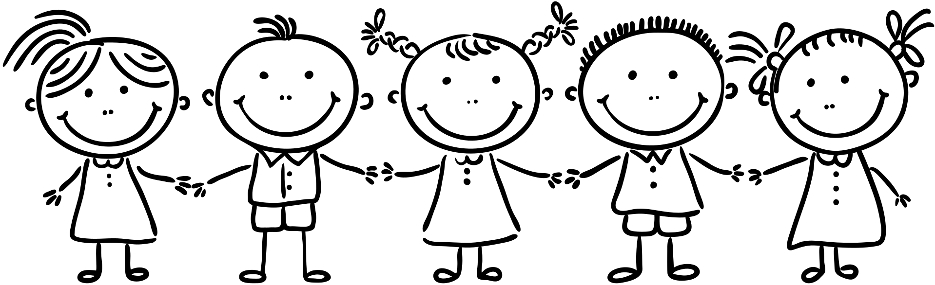

WE DO
Together

Slide 16
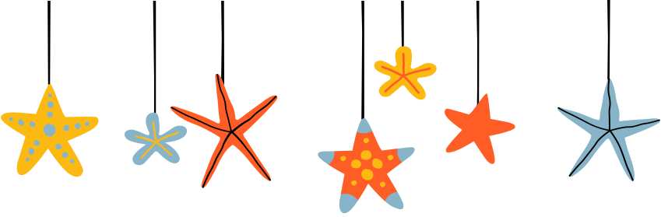

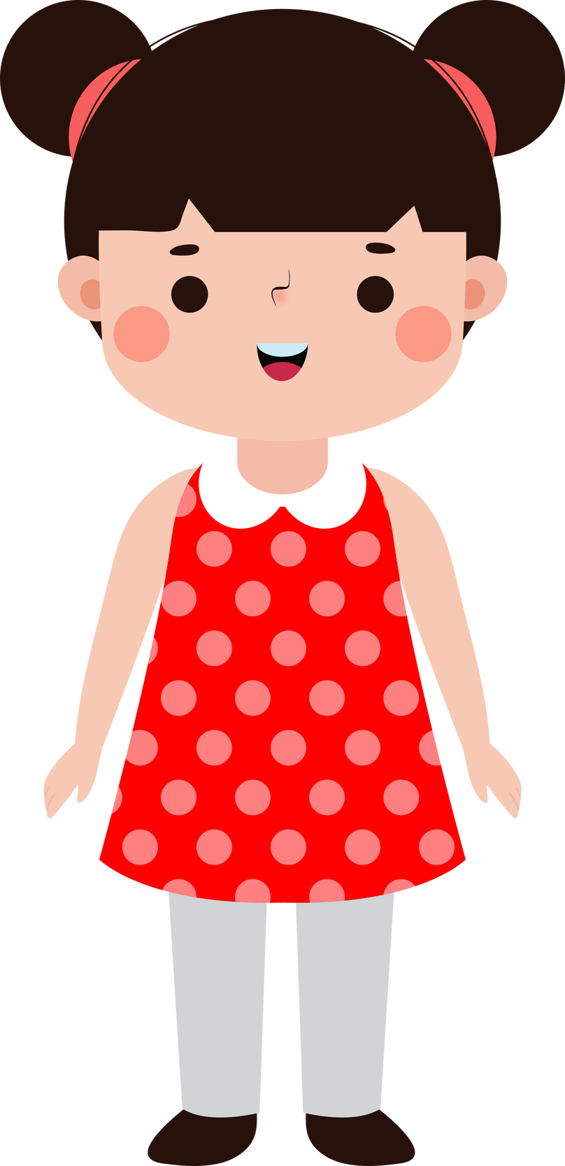
Honesty HEADS or TAILS
Read the following scenario slides. If you think the statement is honest, put your hands on your HEAD! If you think the statement is dishonest, put your hands on your TAIL!
Honest HEADS
Dishonest TAILS

Slide 17
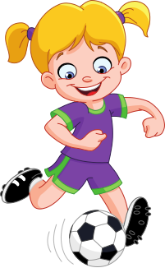
HEADS or TAILS?
SCENARIO:
Nina borrowed her friends ball and did not give it back.
Honest HEADS
Dishonest TAILS

Slide 18
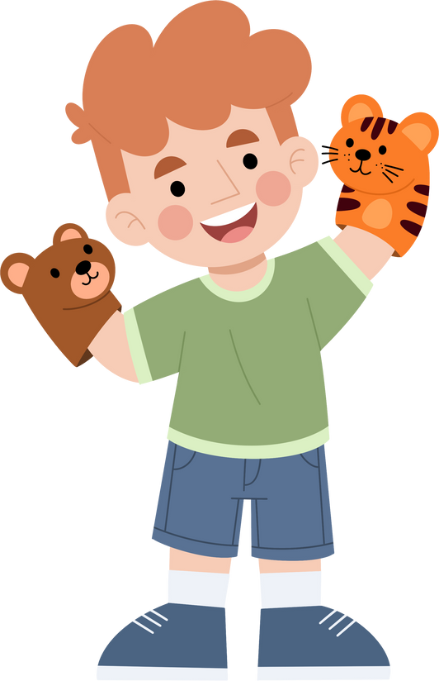
HEADS or TAILS?
SCENARIO:
Oliver realised he had taken his friends toy home after a play date. He returned it to them and apologised.
Honest HEADS
Dishonest TAILS

Slide 19
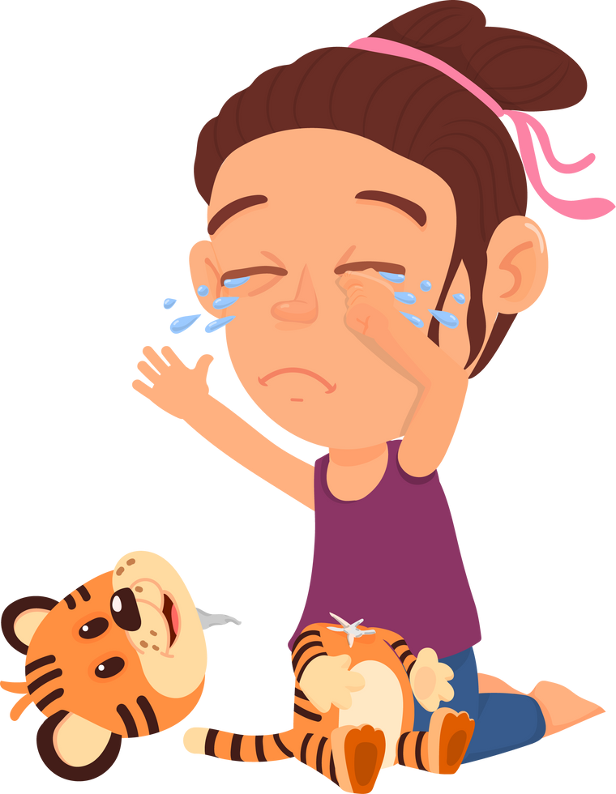
HEADS or TAILS?
SCENARIO:
Isobel broke her cousins favourite toy accidentally. She told her cousin that it was her and she apologised.
Honest HEADS
Dishonest TAILS

Slide 20
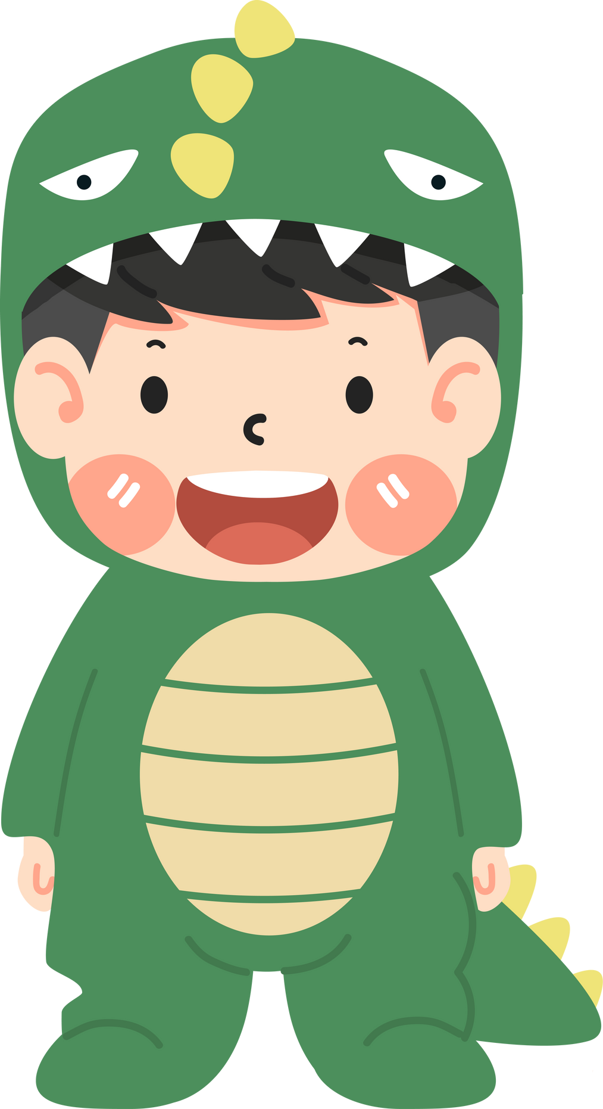
HEADS or TAILS?
SCENARIO:
Jack was invited to his friends birthday party, but pretended to be sick to go to another party.
Honest HEADS
Dishonest TAILS

Slide 21


YOU DO
I support

Slide 22


Ping needs your help!
Now that Ping is Emperor,
he would like to create his
very own honesty garden to
celebrate how he came to
be Emperor!

Slide 23
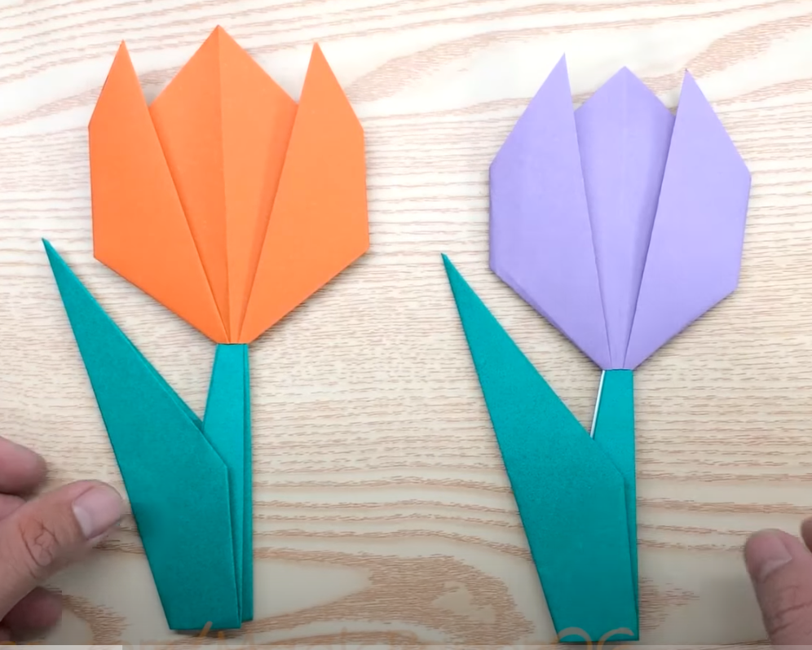
What you need to do...
We are each going to make an origami flower to add to Pings Honesty Garden!

Slide 24
How are you going to do that?
Click HERE to watch a video on how to make the origami flowers.

Slide 25
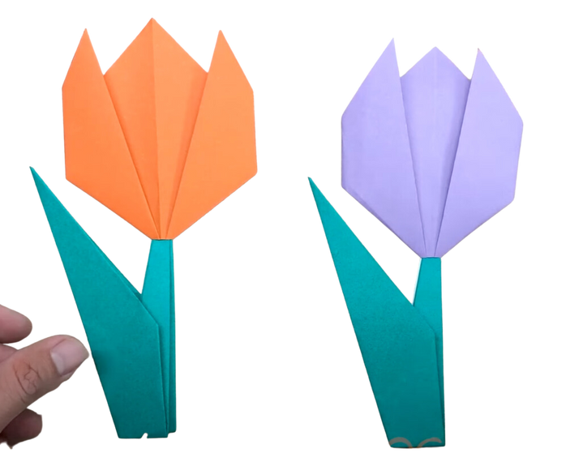

When we are all done...
We are going to put all our flowers together to make
an honesty garden for Ping!

Slide 26
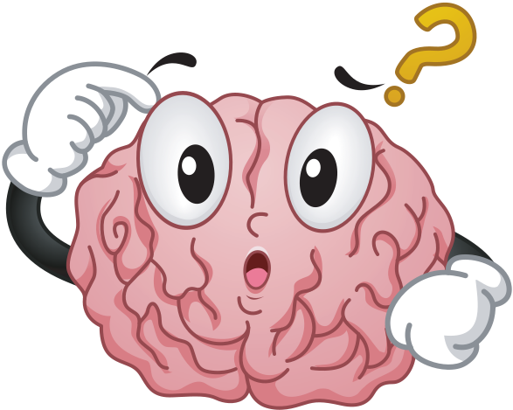
Reflection

Slide 27
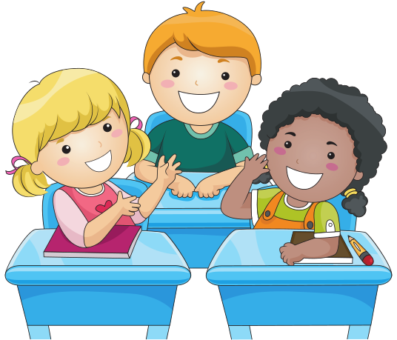
Think Pair Share
What did you
discover
about honesty
today?

Slide 28
Learning Intention:
I am learning about honesty and why it is important
Success Criteria:
I can give examples of what honesty is
I can discuss why being truthful is important
I can explain how honesty is a form of kindness
This Is Because:
When we are honest, our friends and families trust and respect us. Honesty helps our minds and bodies feel
happier too!

